Slide 1
Research Question
Does WIMD 2025 adequately capture rural deprivation
in Wales, and what does that mean for rural-proofing policy?
NOTES:
WIMD 2025 is official Welsh Government statistics. This work does not question the accuracy of the underlying data. It examines a design choice within the methodology This presentation explores how the eight WIMD domains are weighted, and what that design choice means for how rural deprivation is seen.
Anisha Bhattarai
MSc Health Data Science,
University of Aberdeen
Rural Health Compass Placement

Slide 2
Welsh Index of Multiple Deprivation
WIMD is a official statistics used by Welsh Government for policy and funding
It ranks all 1917 small areas(LSOAs) in wales from 1 (most deprived) to 1917 (least deprived)
It combines 8 domains , each measures different deprivation and has fixed weight which is share of final score or rank
A domain rank only moves overall rank in proportion to its weight this is the mechanism this presentation examines
Four dataset used for research :WIMD 2025 Ranks & Scores, Deep-Rooted Deprivation (2005–2025), ONS Rural-Urban Classification 2021

Slide 3
From research question to analysis
Domain comparision
Weight- gap analysis
20 years tracking
Case study
Compare rural vs urban LSOAs across 8 domain
Each domain weight mapping against group rank worse on it
Check rural areas ever appear in persistent deprivation list
Test pattern in local authority as well in one authority(Ceredigion)

Slide 4
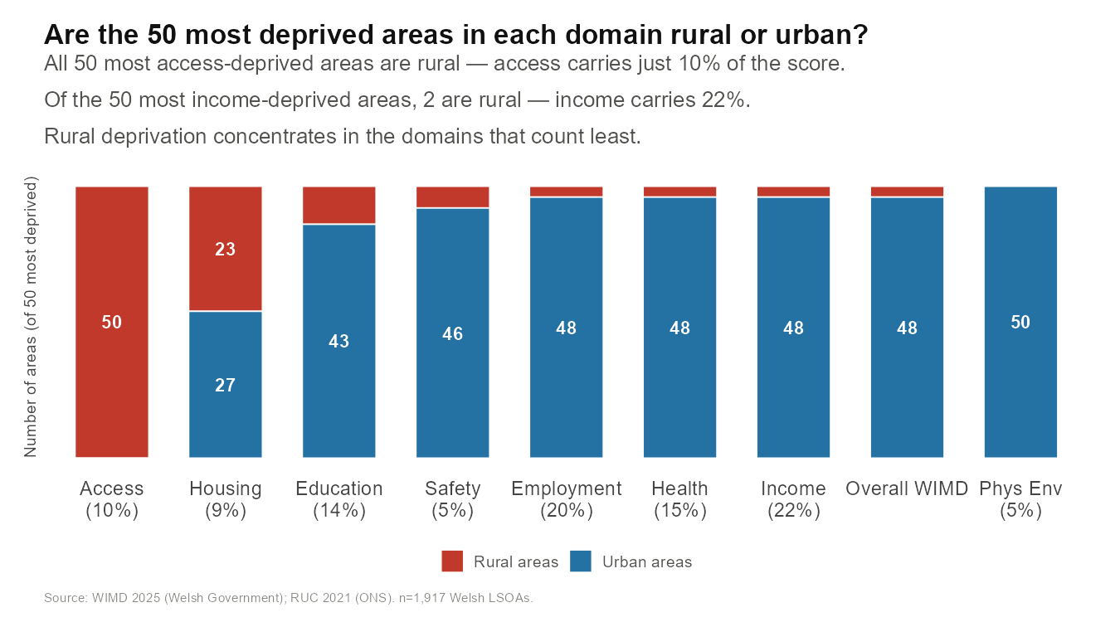
DOMAIN COMPARISON

Slide 5
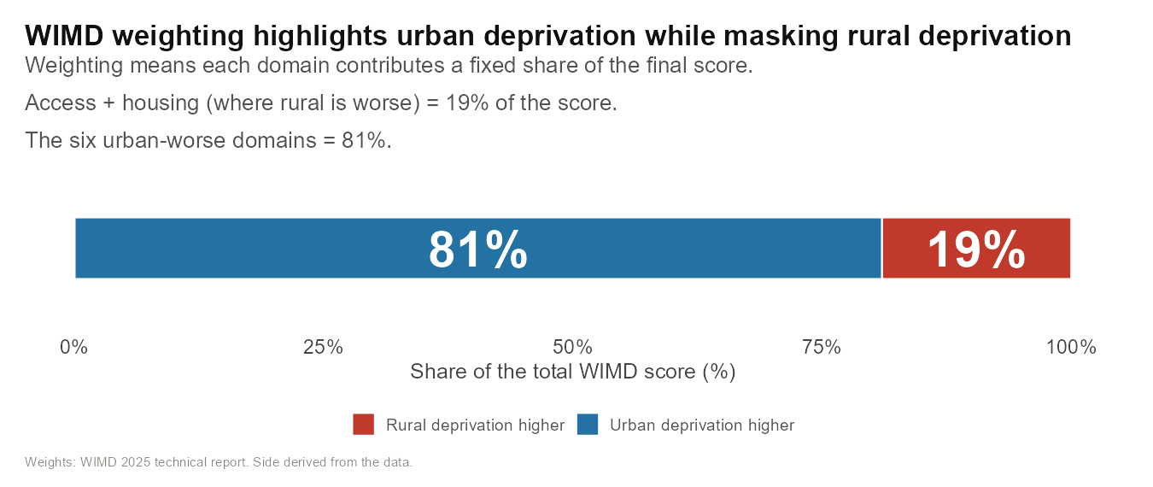
WEIGHT- GAP ANALYSIS
All 8 domain by weight
Income-22%
Employment- 20%
Health- 15%
Education-14%
Access- 10%
Housing- 9%
Safety- 5%
Physical Env. – 5%
Urban deprived
Urban deprived
Urban deprived
Urban deprived
’
Rural deprived
Rural deprived
Urban deprived
Urban deprived

Slide 6
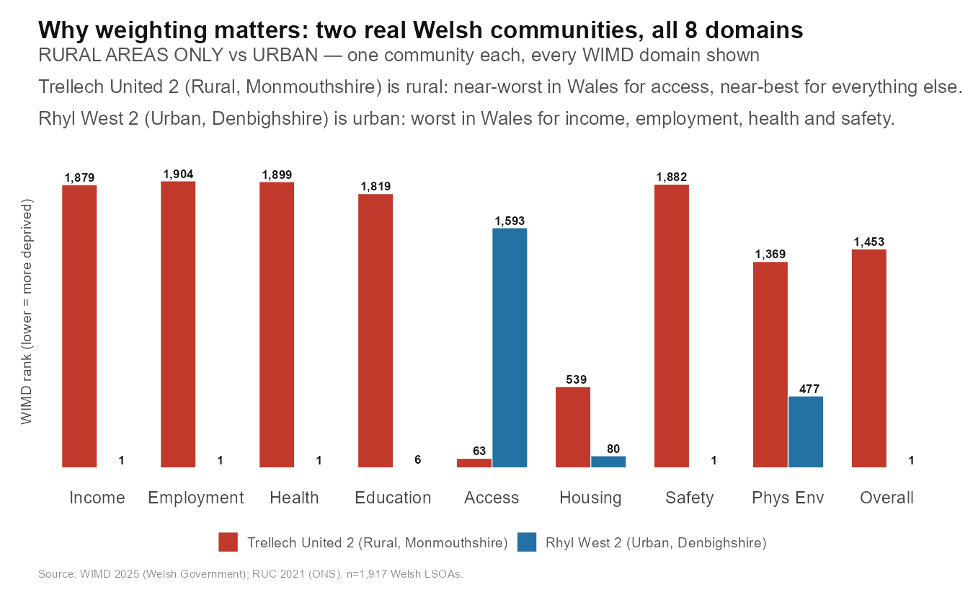
WEIGHT- GAP ANALYSIS

Slide 7
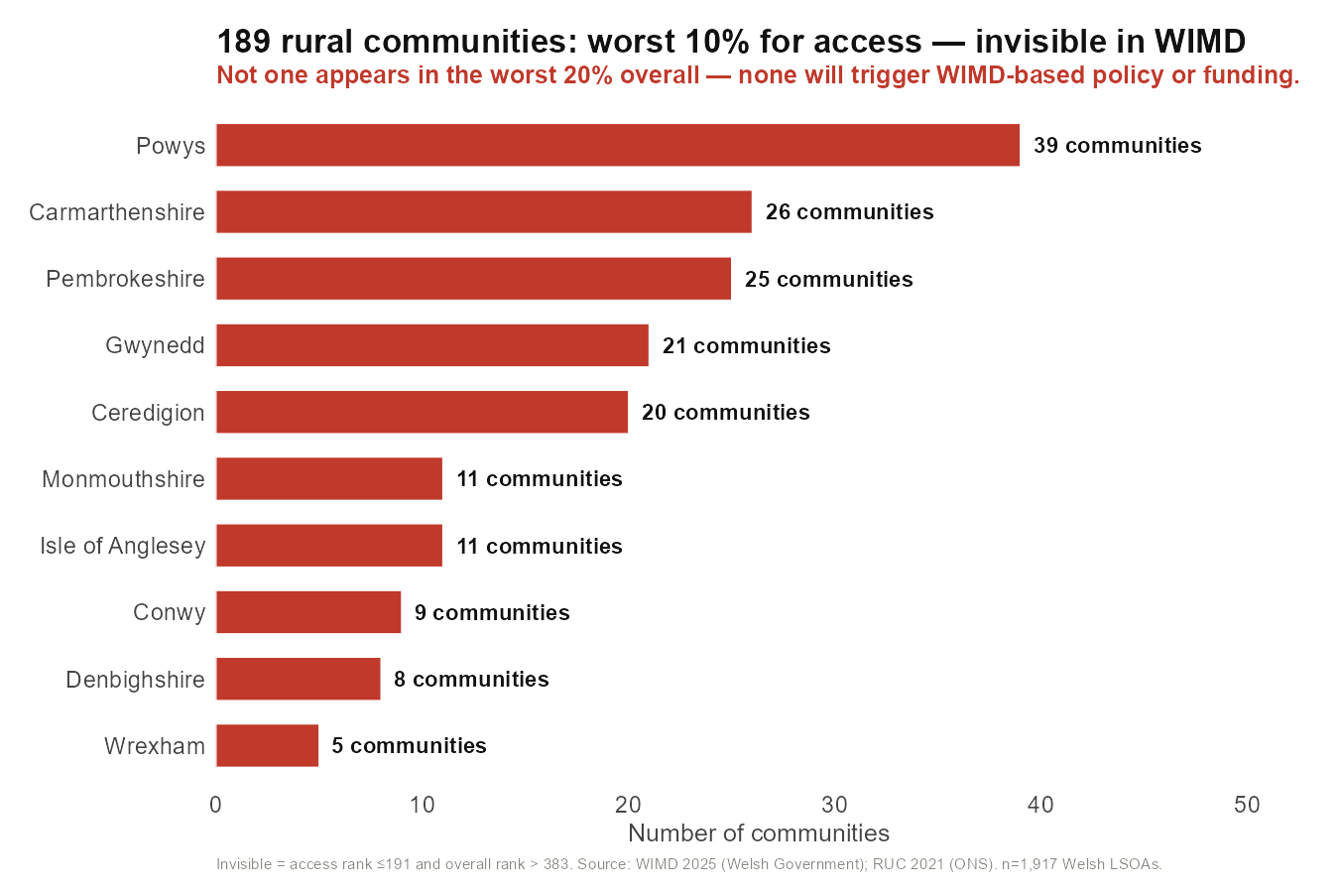
WEIGHT- GAP ANALYSIS
What it costs: 189 invisible communities

Slide 8
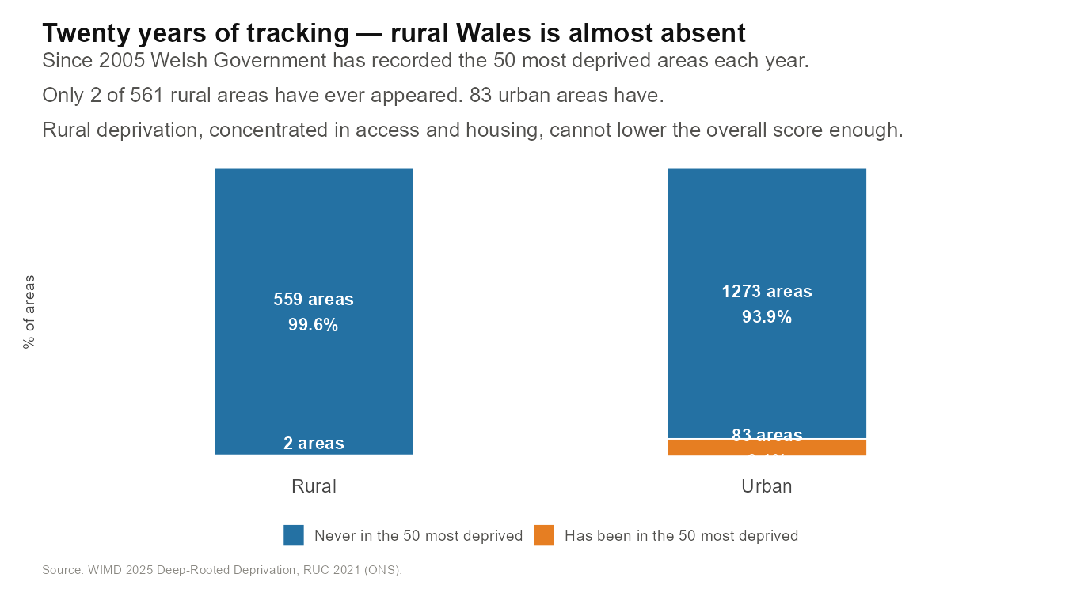
20- YEAR TREND ANALYSIS
WIMD PUBLISHED( DRD 2005-2025) : 2005 · 2008 · 2011 · 2014 · 2019 · 2025

Slide 9
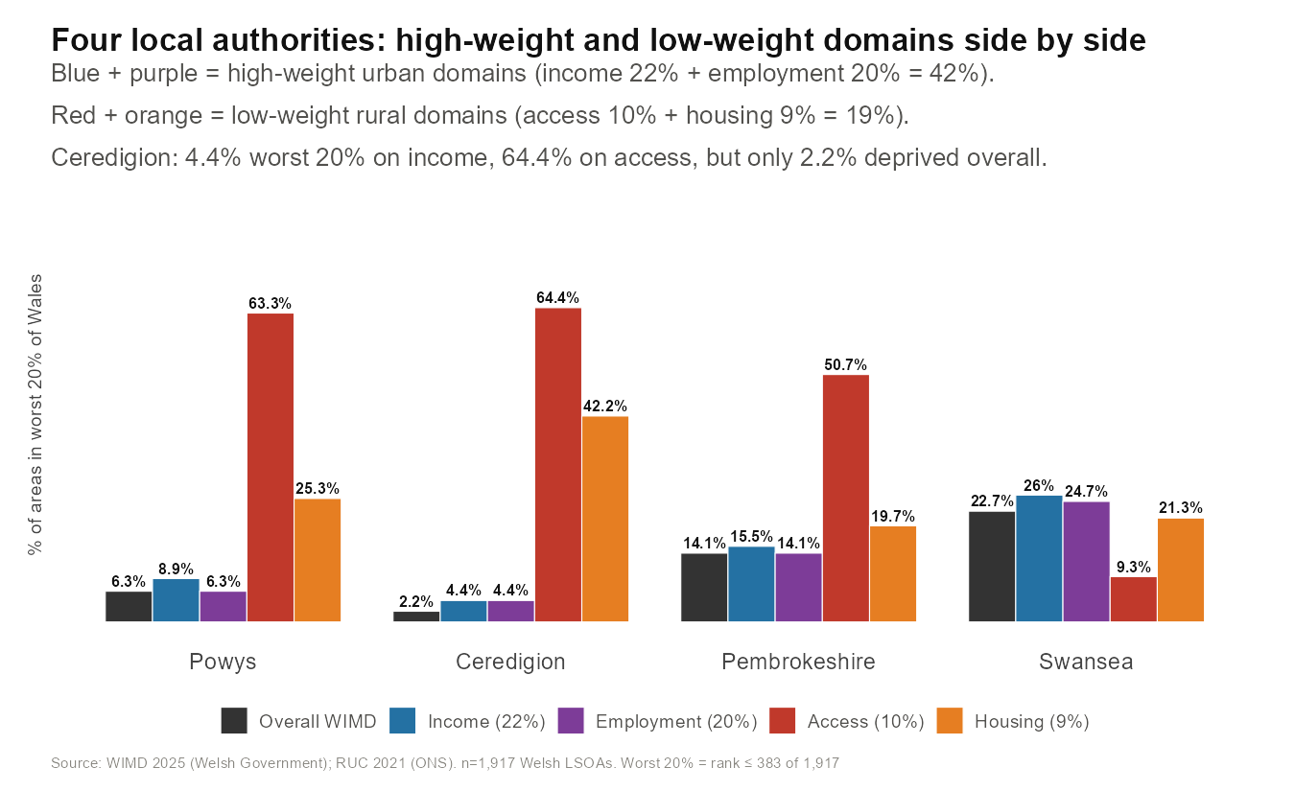
CASE STUDY

Slide 10
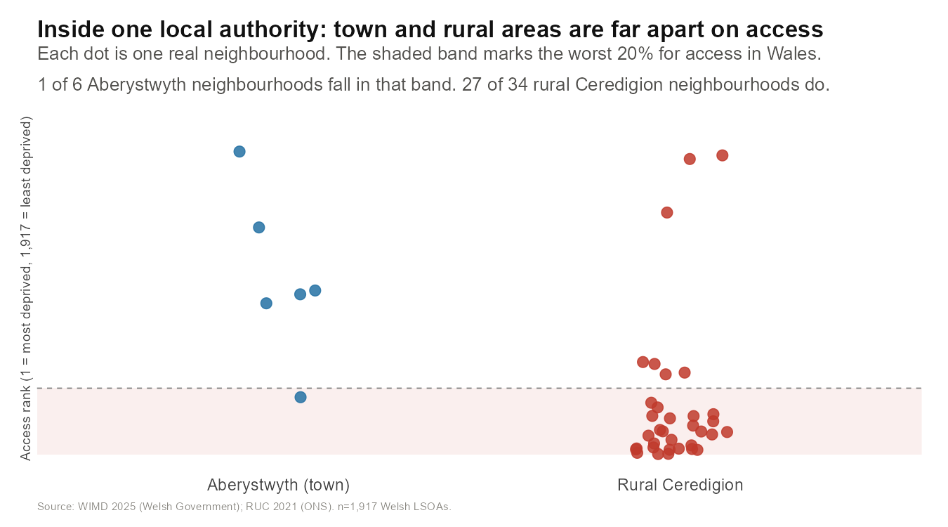
CASE STUDY

Slide 11
Limitation
Rural urban classification uses ONS RUC 2021 categories – small number of LSOAs sits close to the rural/urban boundary and are sensitive to how they are classified
The invisible communities(189) depend on whether worst 10%/ worst 20% threshold are set , pattern hold at neighbouring threshold but exact count moves
Some historical WIMD column(2005- 2025) contains gaps for LSOAs that have since been redrawn, limiting how far back 20 years tracking comparision can be taken with full confidence
This analysis is descriptive and comparative- it identifies pattern of the weighting not causal test of policy impact

Slide 12
What this analysis does- and doesnot- say about WIMD
This analysis doesnot question accuracy of WIMD’s underlying domain data. WIMD DOMAIN rank are official goverment statistics
This findings concern how validated domain data are COMBINED in one weight score- a question of statistical design, not data quality
The health- access correlation(r=-0.443) is consistent with under-recording in remote areas, but data cannot confirm why health of rural areas is well
WIMD remain best multi-domain measure for deprivation in wales, our recommendation to supplement it for rural policy not to replace it
This analysis cannot say whether reweighting domains would have unintended effect on urban deprivation targeting that requires further modeling beyond this project

Slide 13
What analysis means for rural proofing policy
Use domain level ranks alongside the overall WIMD rank when funding or service decision made
Consider whether access and housing weights reflect true impact on rural quality of life, alongside existing evidence base to set them
Use the 189 communities as starting point for targeted rural service review
Apply rural lens check to any policy that solely depend on the overall WIMD rank
Report at small area level within local authorities , so town good access doesnot average away a rural poor access( as seen in Ceredigion)

Slide 14
Question raised by this project
WIMD isnot wrong – it is doing exactly its weight were designed to do.
Does those weights still reflect what rural communities need policy to see?

Slide 15
Thank you

